Slide 1
Scientific Machine Learning for Optimization and Control: a Unifying View
Ján Drgoňa
Associate Professor Civil and Systems Engineering Department
Department of Electrical and Computer Engineering (secondary) The Ralph O'Connor Sustainable Energy Institute (ROSEI)
Data Science and AI Institute (DSAI)

Slide 2
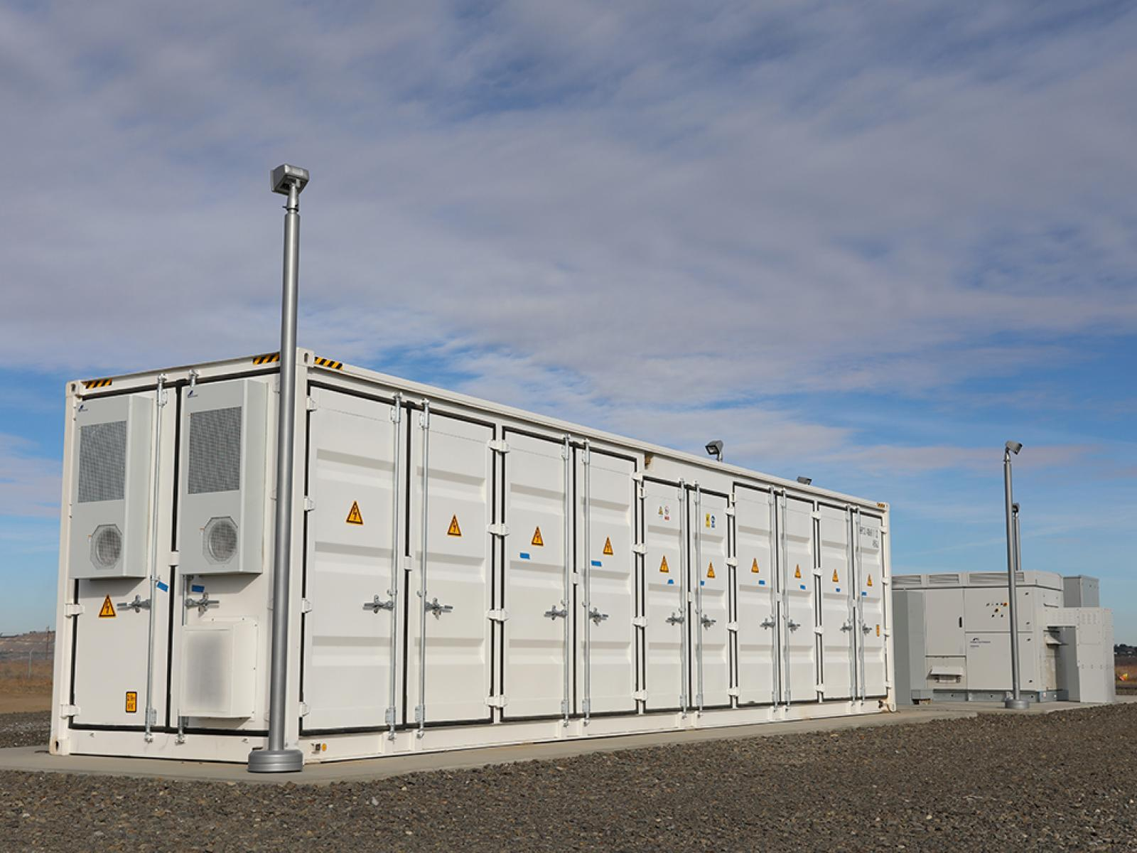
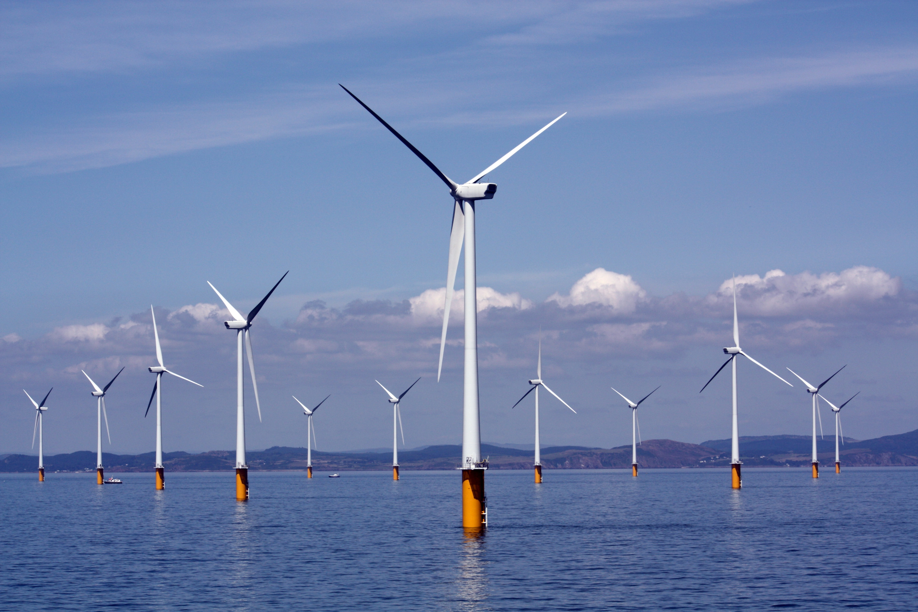
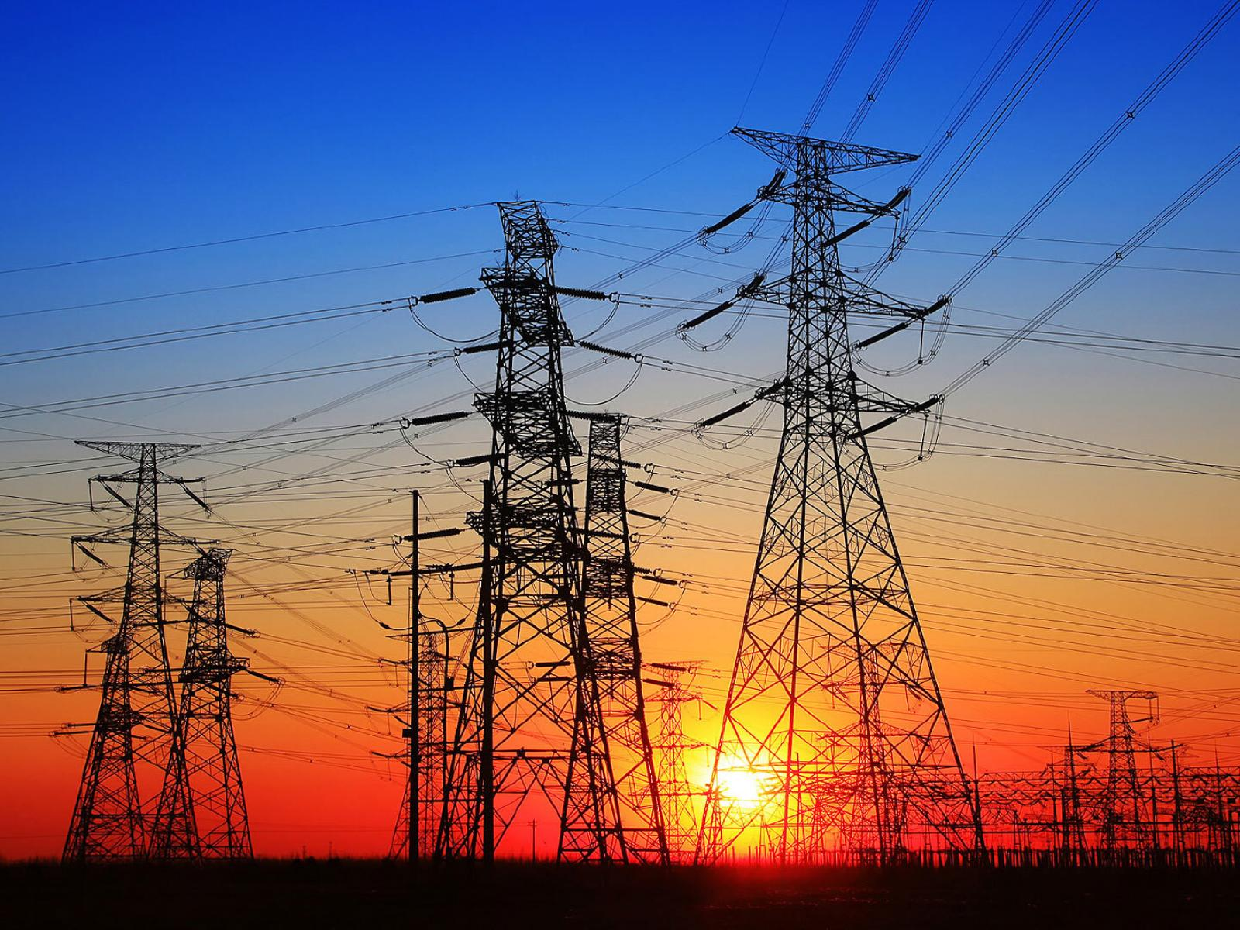

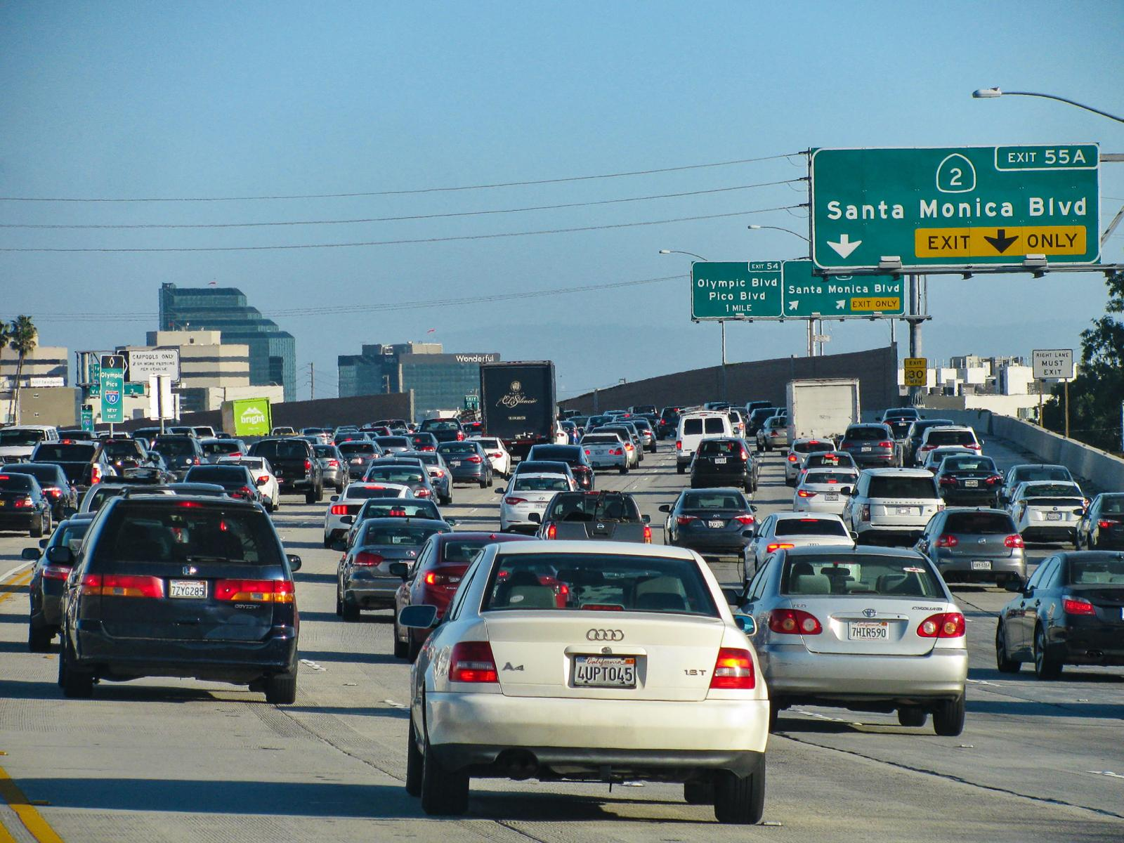
Optimizing Complex Energy Systems is Hard
Simulations are crucial for optimal decision-making in complex energy systems
Need: Improve computational efficiency and scalability of digital twins and optimization-based decision-making
Challenges:
Modeling and simulation of complex systems is hard
Closed-loop decision-making for complex systems is hard-er
Scientific computing and machine learning tools are fragmented and not easily composable

Slide 3
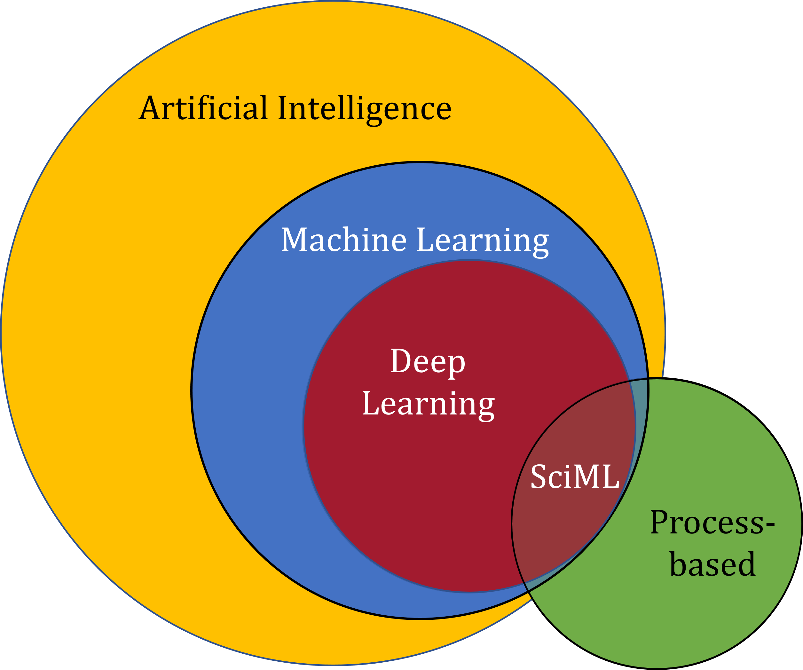
Scientific Machine Learning (SciML)
What?
SciML systematically integrates ML methods with mathematical models and algorithms developed in various scientific and engineering domains
Why?
Scientific applications are governed by fundamental principles and physical constraints
Purely data-driven “black box” ML methods cannot satisfy underlying physics
How?
Leverage automatic differentiation used in learning for modeling, optimization, and control
Karniadakis, G.E., Kevrekidis, I.G., Lu, L. et al. Physics-informed machine learning. Nat Rev Phys 3, 422–440, 2021.
Image source: https://sciml.wur.nl/reviews/sciml/sciml.html

Slide 4
Selected Scientific Machine Learning Literature
Differentiable Programming
M. Innes, et al., A Differentiable Programming System to Bridge Machine Learning and Scientific Computing, 2019
Learning to Solve (L2S)
M. Raissi, et al., Physics-informed neural networks: A deep learning framework for solving forward and inverse problems involving nonlinear partial differential equations, 2019
Learning to Optimize (L2O)
A. Agrawal, et al., Differentiable Convex Optimization Layers, 2019
P. Donti, et al., DC3: A learning method for optimization with hard constraints, 2021
J. Kotary, et al., End-to-End Constrained Optimization Learning: A Survey, 2021
R. Sambharya, et al., Learning to warm-start fixed-point optimization algorithms, 2024
Learning to Model (L2M)
B. Lusch, et al., Deep learning for universal linear embeddings of nonlinear dynamics, 2018
R. T. Q. Chen, et al., Neural Ordinary Differential Equations, 2019
C. Rackauckas, et al., Universal Differential Equations for Scientific Machine Learning, 2021
Learning to Control (L2C)
B. Amos, et al., Differentiable MPC for End-to-end Planning and Control, 2019
S. East, et al., Infinite-Horizon Differentiable Model Predictive Control, 2020
Y Qiao, et al., Scalable Differentiable Physics for Learning and Control, 2020

Slide 5
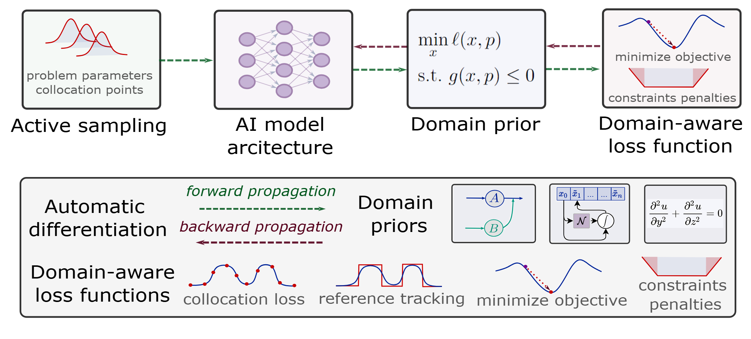
Components of Scientific Machine Learning
Karniadakis, G.E., Kevrekidis, I.G., Lu, L. et al. Physics-informed machine learning. Nat Rev Phys 3, 2021.
Thiyagalingam, J., Shankar, M., Fox, G. et al. Scientific machine learning benchmarks. Nature Reviews Physics 4, 413–420, 2022.
Nghiem T., Drgona J., et al. Physics-Informed Machine Learning for Modeling and Control of Dynamical Systems, ACC, 2023.

Slide 6

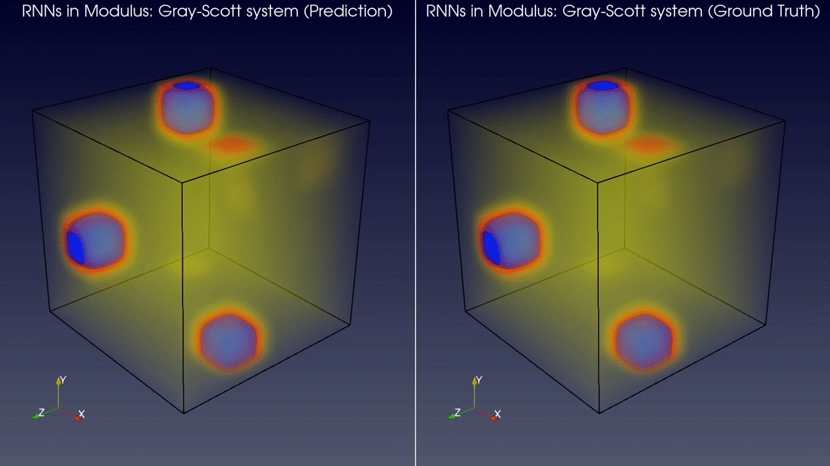
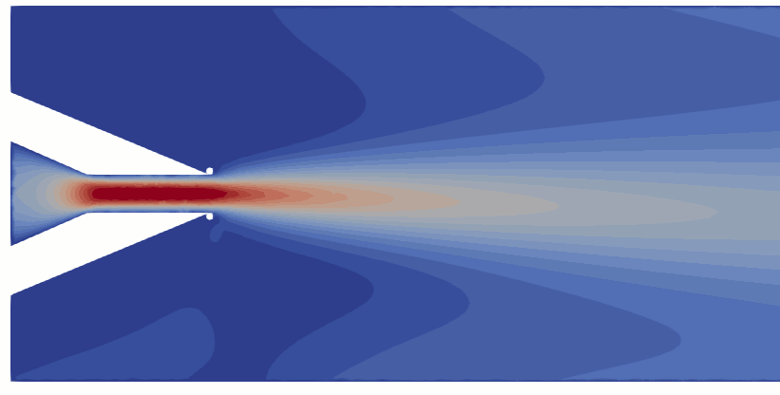
Learning to Solve Differential Equations with Physics-Informed Neural Networks (PINNs)
Training neural networks as PDE solutions
Application: Parameter estimation from data
M. Raissi, et al., Physics-informed neural networks: A deep learning framework for solving forward and inverse problems involving nonlinear partial differential equations, Journal of Computational Physics, 2019
Images: NVIDIA Modulus

Slide 7
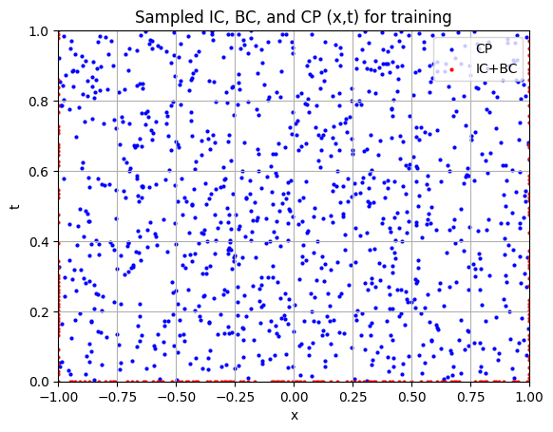
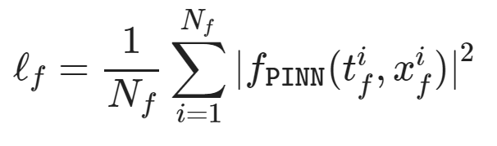
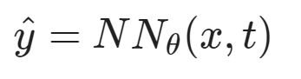
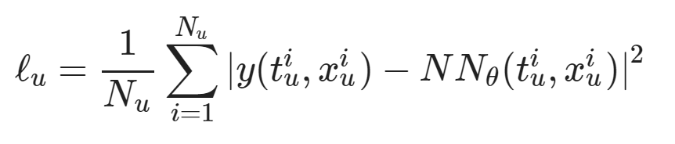
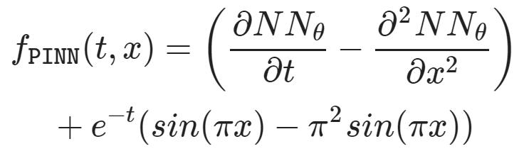
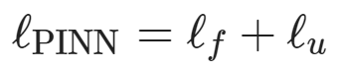
Learning to Solve Differential Equations with Physics-Informed Neural Networks (PINNs)
Dataset: collocation points in the spatio-temporal coordinates.
Architecture: PDE equations solved with neural network via automatic differentiation.
Loss function: minimizing PDE equation, initial and boundary condition residuals.
https://github.com/pnnl/neuromancer/blob/master/examples/PDEs/Part_2_PINN_BurgersEquation.ipynb
M. Raissi, et al., Physics-informed neural networks: A deep learning framework for solving forward and inverse problems involving nonlinear partial differential equations, Journal of Computational Physics, 2019

Slide 8
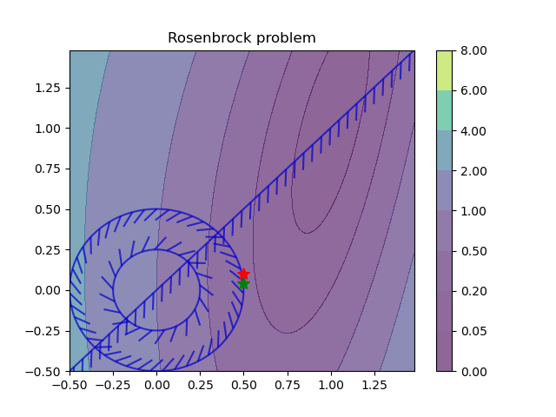
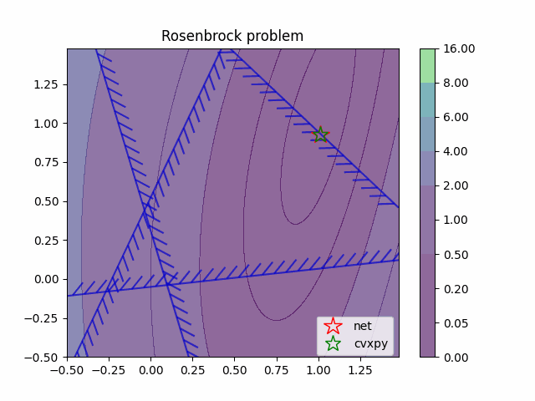
Learning to Optimize (L2O) with Constraints
Training neural networks as optimization solutions
Application: solving optimal power flow
James Kotary, et al., End-to-End Constrained Optimization Learning: A Survey, IJCAI, 2021

Slide 9
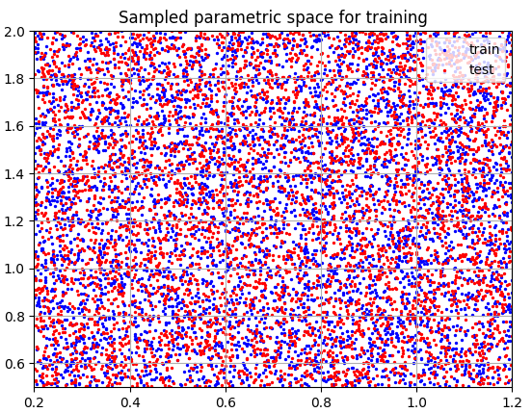
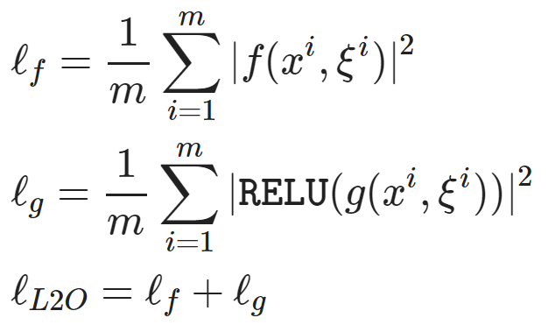
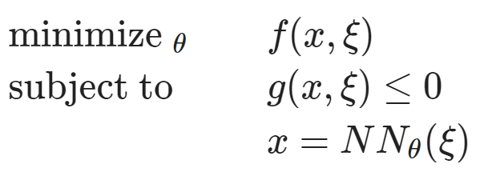
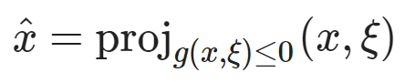
Learning to Optimize (L2O) with Constraints
Dataset: collocation points in the parametric space.
Architecture: differentiable optimization solver with neural network surrogate.
Loss function: minimizing objective function and constraints penalties.
https://github.com/pnnl/neuromancer/blob/master/examples/parametric_programming/Part_1_basics.ipynb
A. Agrawal, et al., Differentiable Convex Optimization Layers, 2019
P. Donti, et al., DC3: A learning method for optimization with hard constraints, 2021

Slide 10
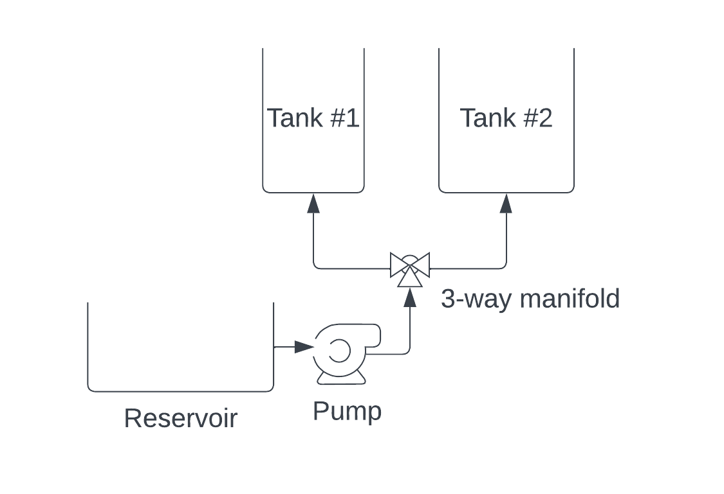
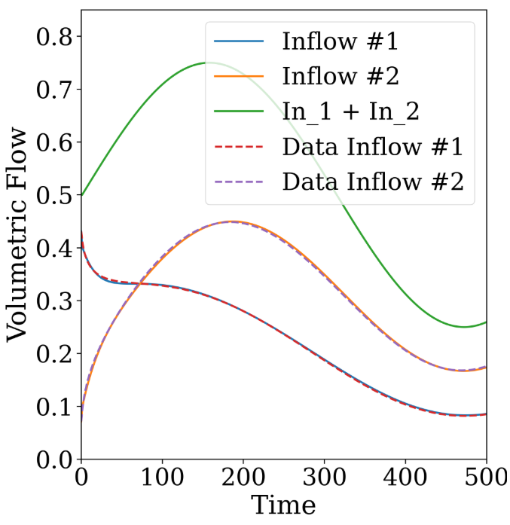
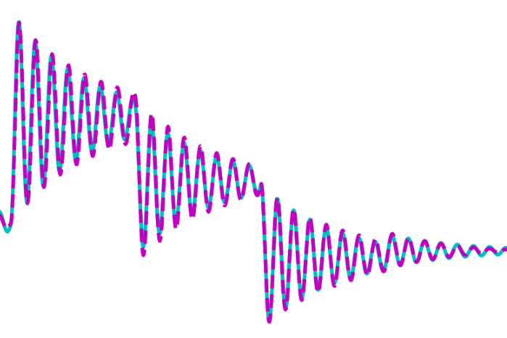
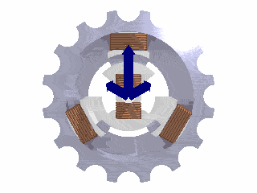
Learning to Model (L2M) Dynamical Systems
Nonlinear system identification
Applications: modeling process dynamics
R. T. Q. Chen, et al., Neural ordinary differential equations. NeurIPS, 2018
C. Rackauckas, et al., Universal Differential Equations for Scientific Machine Learning, 2021
James Koch, et al., Learning Neural Differential Algebraic Equations via Operator Splitting, CDC, 2025

Slide 11
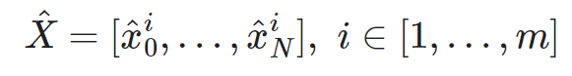
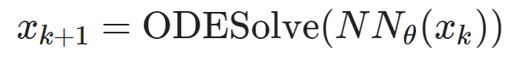
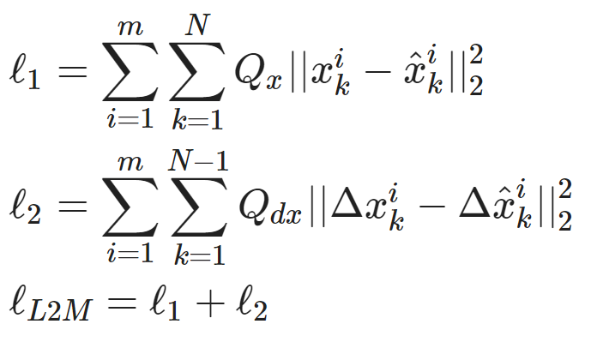
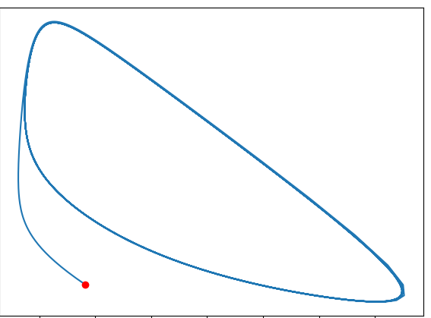
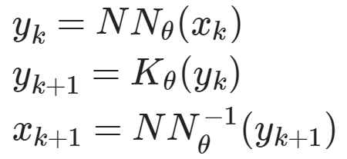
Learning to Model (L2M) Dynamical Systems
Dataset: time-series of states, inputs, and disturbances tuples.
Architecture: differentiable ODE solver with neural network model.
Loss function: trajectory matching, regularizations, and constraints penalties.
Architecture: Koopman operator with neural network basis functions.
https://github.com/pnnl/neuromancer/blob/master/examples/ODEs/Part_1_NODE.ipynb
R. T. Q. Chen, et al., Neural Ordinary Differential Equations, 2019
B. Lusch, et al., Deep learning for universal linear embeddings of nonlinear dynamics, 2018

Slide 12
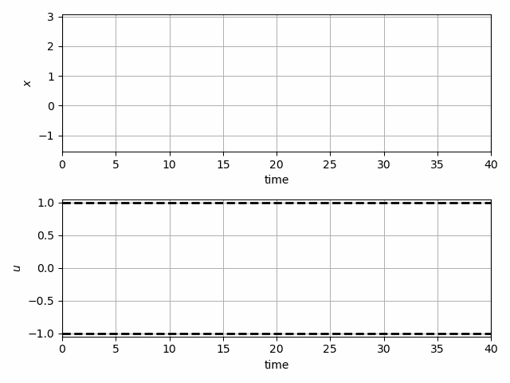
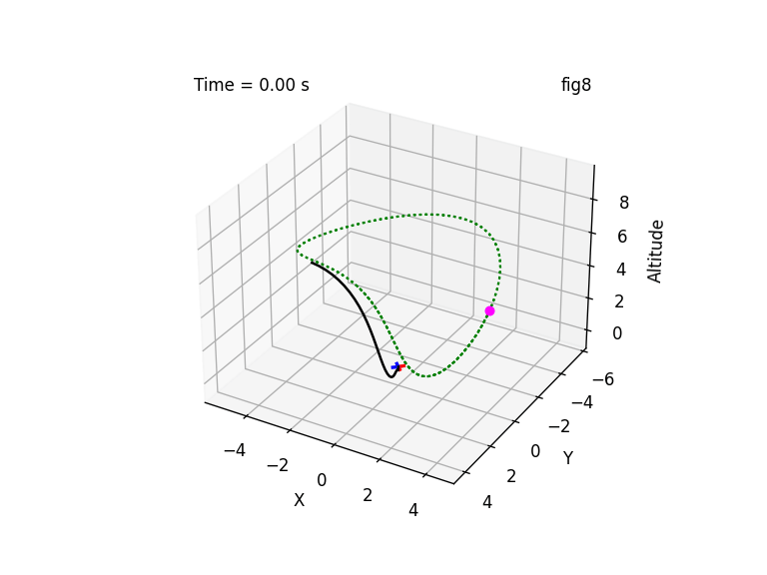
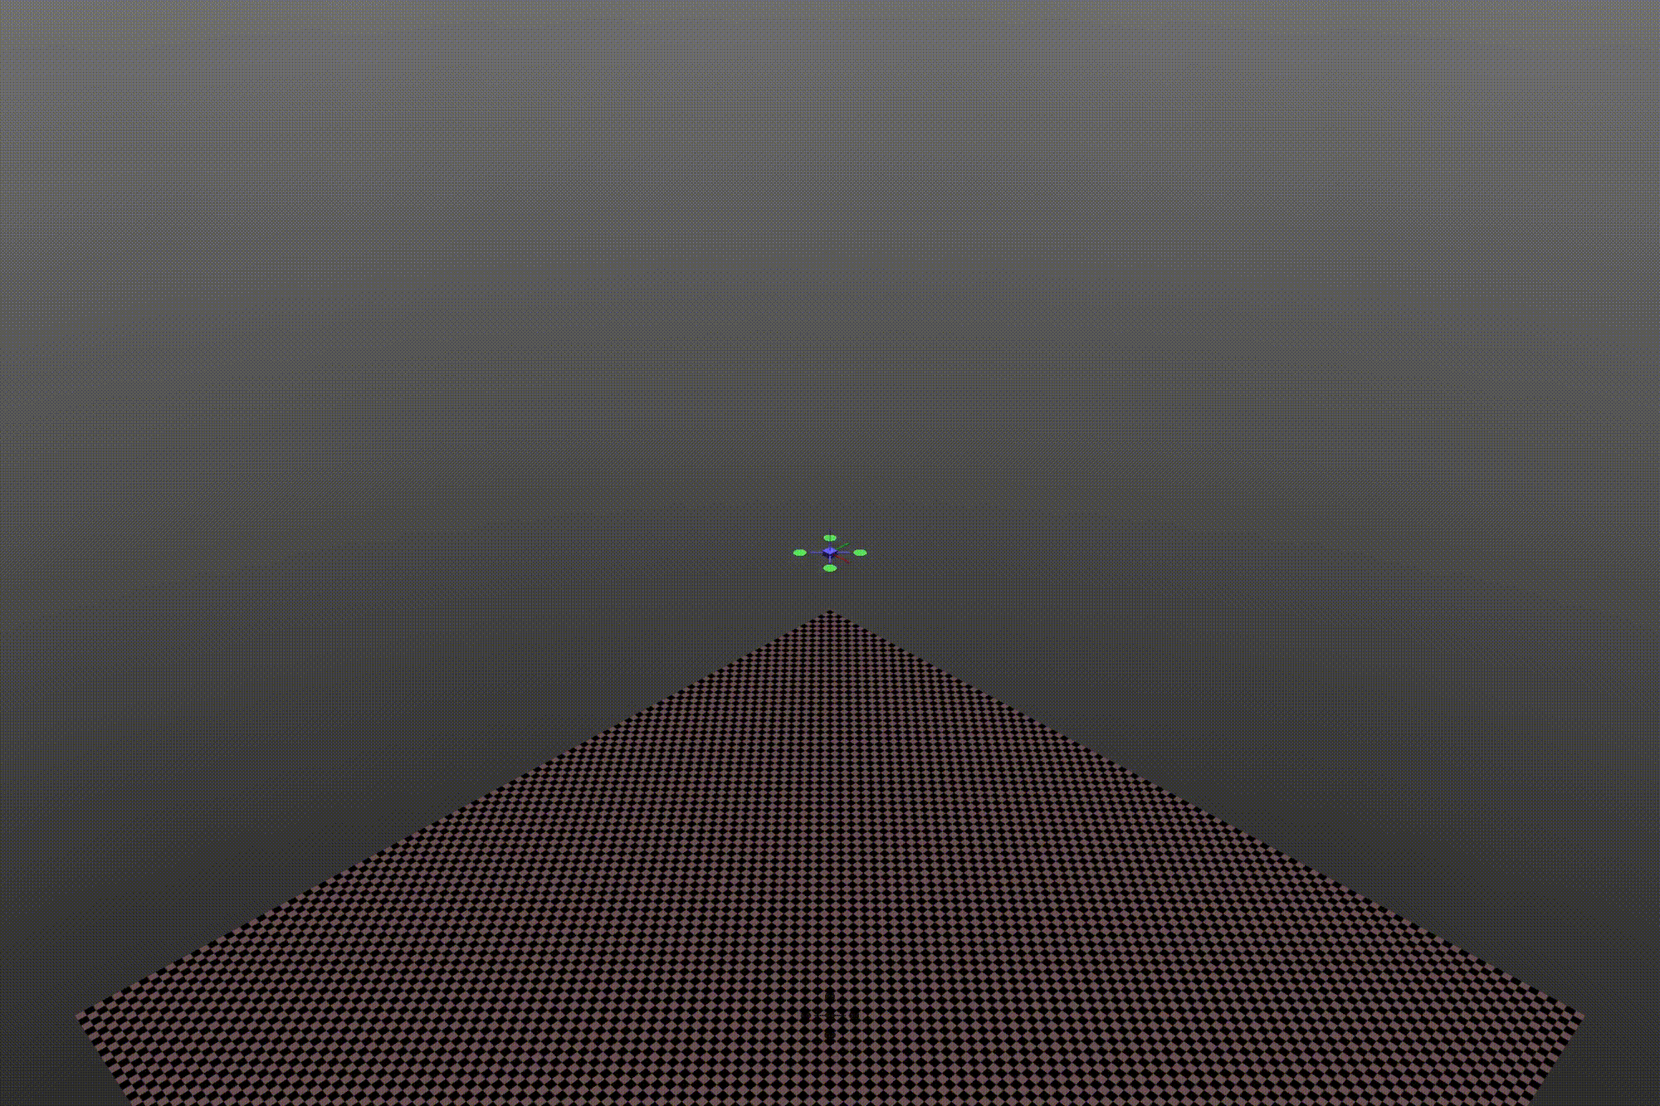
Learning to Control (L2C) via Differentiable Predictive Control (DPC)
Trajectory optimization for dynamical systems
Application: autonomous systems
J. Drgoňa, A. Tuor and D. Vrabie, "Learning Constrained Parametric Differentiable Predictive Control Policies With Guarantees," in IEEE Transactions on Systems, Man, and Cybernetics: Systems, 2024

Slide 13
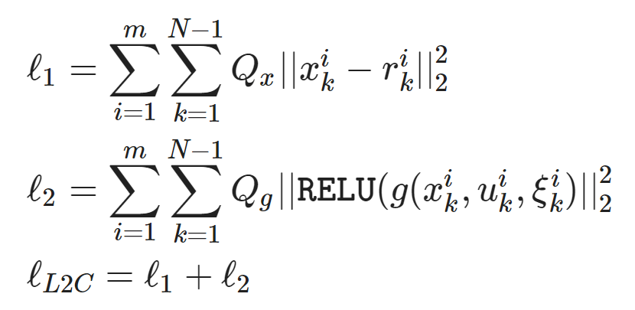
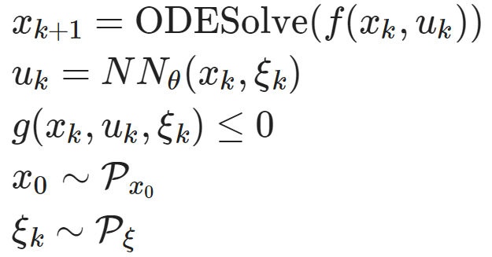
Learning to Control (L2C) via Differentiable Predictive Control (DPC)
Dataset: collocation points in the control parametric space.
Architecture: differentiable model with neural network control policy.
Loss function: reference tracking, constraints and terminal penalties.
https://github.com/pnnl/neuromancer/blob/master/examples/control/Part_3_ref_tracking_ODE.ipynb
J. Drgoňa, A. Tuor and D. Vrabie, "Learning Constrained Parametric Differentiable Predictive Control Policies With Guarantees," in IEEE Transactions on Systems, Man, and Cybernetics: Systems, 2024

Slide 14

NeuroMANCER Scientific Machine Learning Library
Open-source library in PyTorch
Physics-informed Neural Networks
Learning to optimize
Neural differential equations
Learning to control
github.com/pnnl/neuromancer

Slide 15
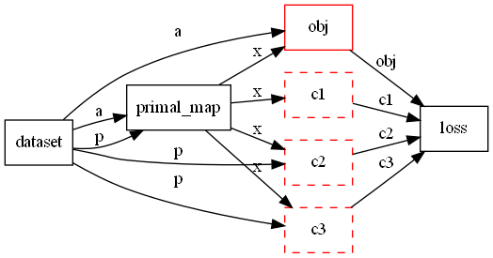
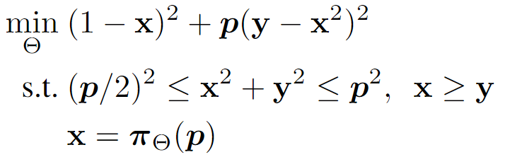

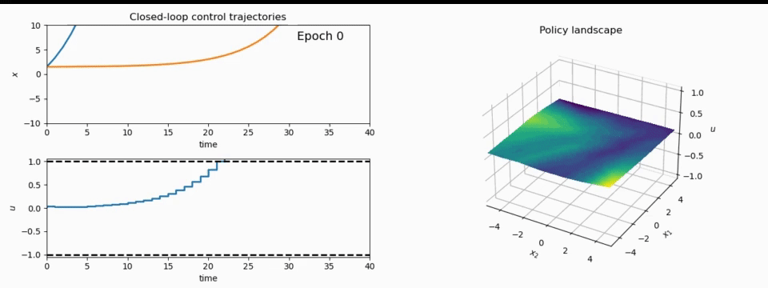
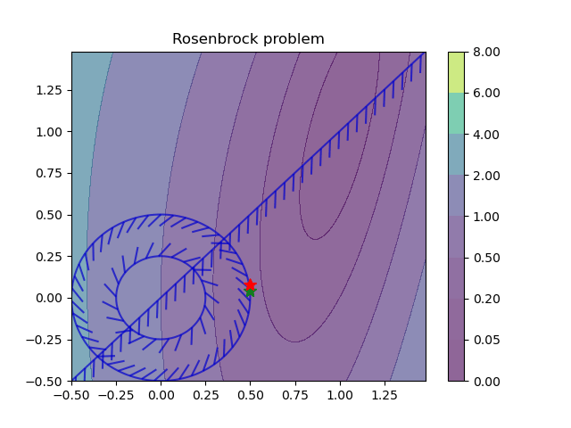
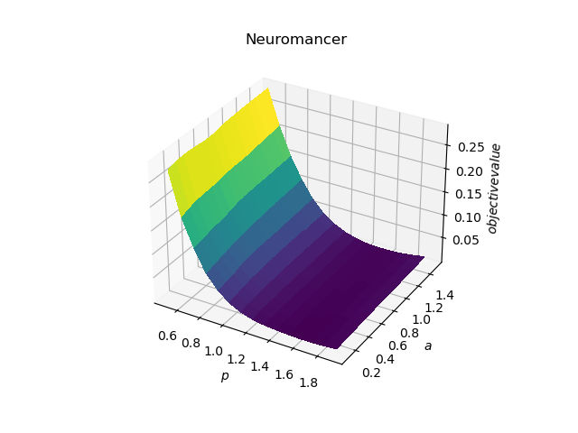
NeuroMANCER Scientific Machine Learning Library
1. Mathematical formulation
3. Problem graph
map
2. Python code interface
4. Results
import neuromancer as nm
p = nm.variable(‘p’)
x = nm.variable(‘x’)
y = nm.variable('y’)
obj = ((1-x)**2 + p*(y-x**2)**2).minimize(weight=1.0, name='obj’) c1 = (p/2)**2 <= x**2 + y**2
c2 = x**2 + y**2 <= p**2
c3 = x >= y net = nm.MLP(insize=2, outsize=2, hsizes=[80]*4) map = nm.Node(net, input_keys=['p’], output_keys=[‘x’,‘y’])
loss = nm.PenaltyLoss([obj], [c1, c2, c3]) problem = nm.Problem([map], loss)
optimizer = torch.optim.AdamW(problem.parameters()) trainer = nm.Trainer(problem,data,optimizer)
best_model = trainer.train()

Slide 16




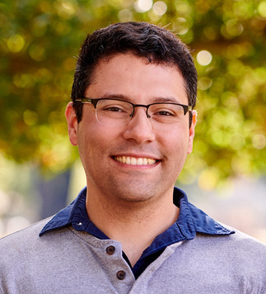



NeuroMANCER Development Team
Ján Drgoňa
Aaron Tuor
James Koch
Madelyn Shapiro
Bruno
Jacob
Draguna
Vrabie

Slide 17
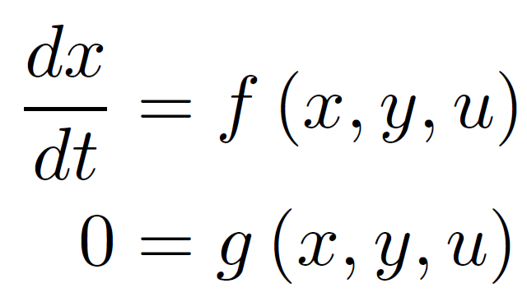
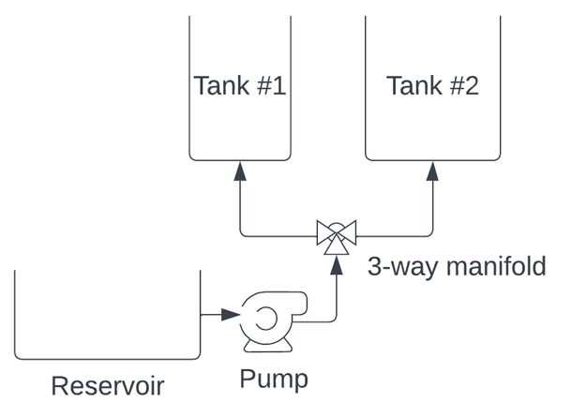
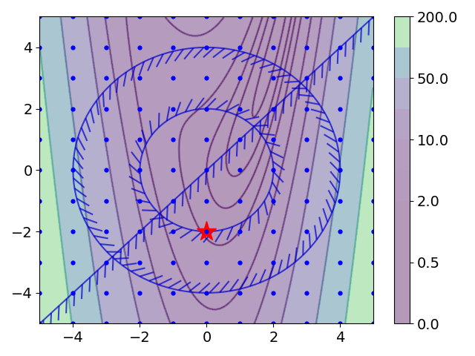
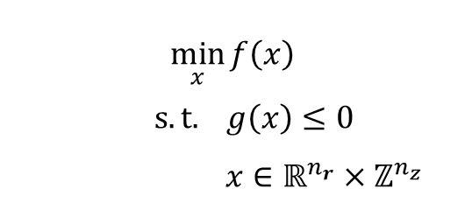
Some Challenges
Differential Algebraic Constraints
Mixed-Integer Decision Space
$$\min_{x}{f\left(x\right)}$$
$$s.t. g\left(x\right)≤0$$
$$x∈ℝ^{n_{r}}×ℤ^{n_{z}}$$

Slide 18
Some Challenges
Differential Algebraic Constraints
Mixed-Integer Decision Space
$$\min_{x}{f\left(x\right)}$$
$$s.t. g\left(x\right)≤0$$
$$x∈ℝ^{n_{r}}×ℤ^{n_{z}}$$

Slide 19
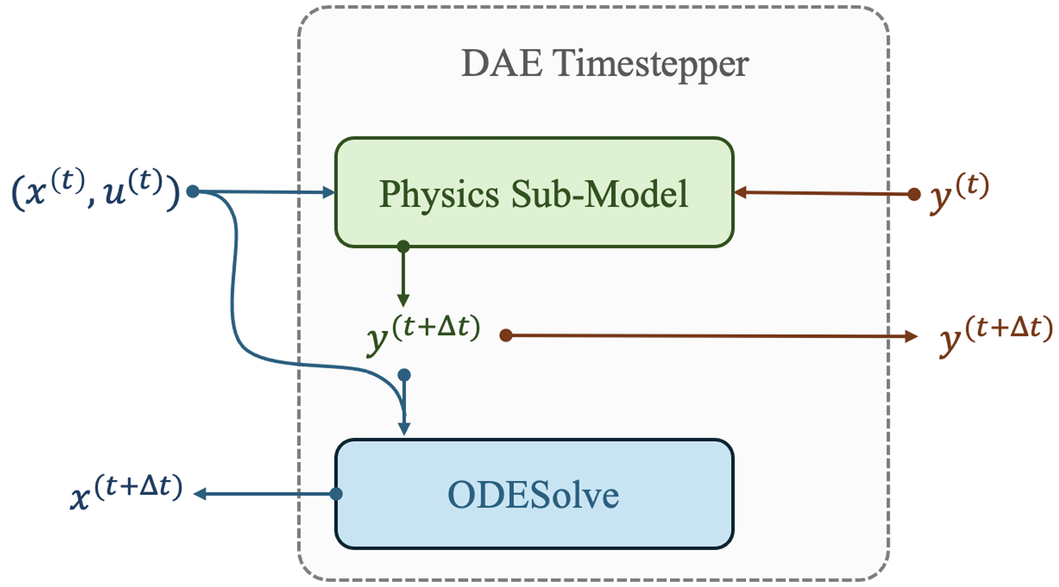
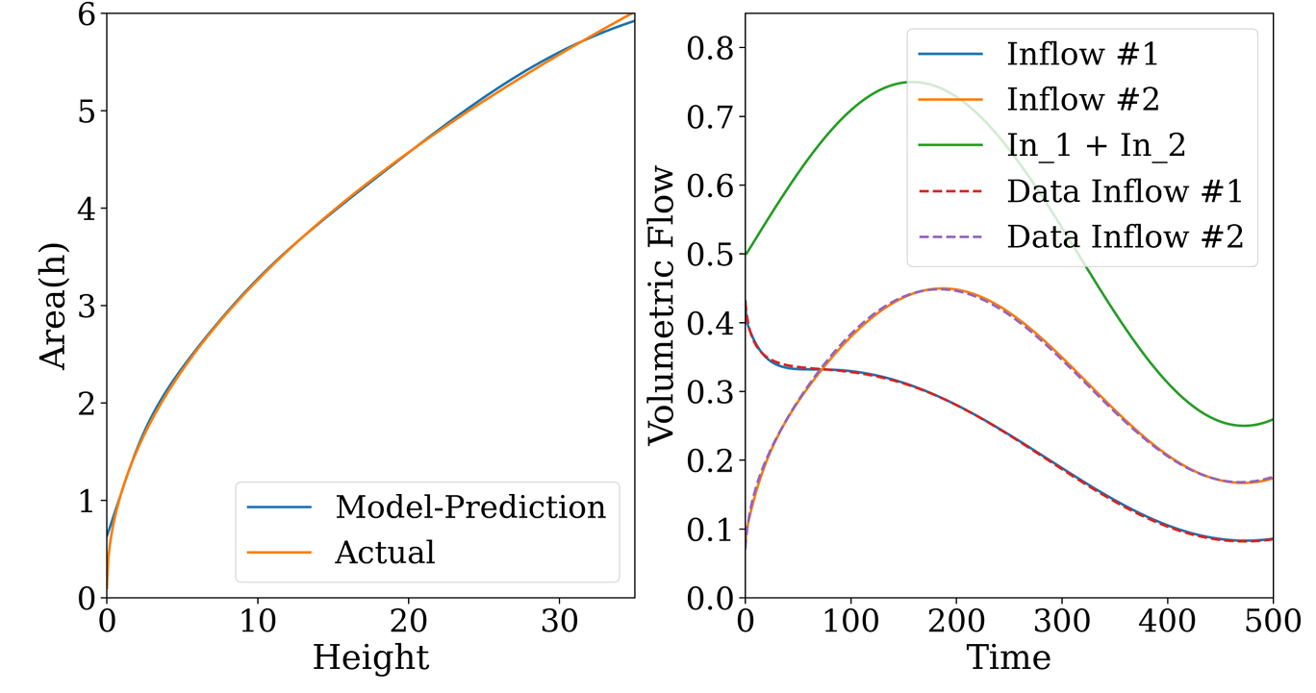
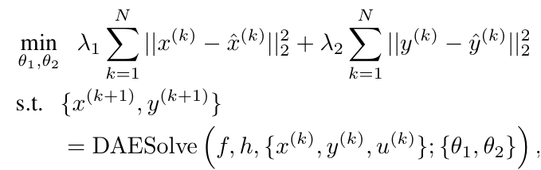
Learning Neural Differential Algebraic Equations via Operator Splitting
Neural DAE learning problem:
Inverse modeling, robustness to noise and, out of distribution generalization.
https://drgona.github.io/NeuralDAEs/
J. Koch, M. Shapiro, H. Sharma, D. Vrabie, J. Drgona, Learning Neural Differential Algebraic Equations via Operator Splitting, arXiv:2403.12938, 2024.

Slide 20

Authors of Learning Neural Differential Algebraic Equations via Operator Splitting
James Koch
Madelyn Shapiro
Himanshu
Sharma
Draguna
Vrabie
Ján Drgoňa

Slide 21
Some Challenges
Differential Algebraic Constraints
Mixed-Integer Decision Space
$$\min_{x}{f\left(x\right)}$$
$$s.t. g\left(x\right)≤0$$
$$x∈ℝ^{n_{r}}×ℤ^{n_{z}}$$

Slide 22



Authors of Learning to Optimize for Mixed-Integer Non-Linear Programming with Feasibility Guarantees
Bo Tang
PhD Candidate
Department of Mechanical & Industrial Engineering
University of Toronto
Elias B. Khalil
Assistant Professor
Department of Mechanical & Industrial Engineering
University of Toronto
SCALE AI Research Chair
Data-Driven Algorithms for Modern Supply Chains
Ján Drgoňa
Associate Professor
Department of Civil and Systems Engineering and the Ralph S. O’Connor Sustainable Energy Institute
Johns Hopkins University
Bo Tang, Elias B. Khalil, Ján Drgoňa, Learning to Optimize for Mixed-Integer Non-linear Programming with Feasibility Guarantees, arXiv:2410.11061, 2024

Slide 23

Summary
Scientific machine learning (SciML) methods integrating deep learning, constrained optimization, physics-based modeling, and control
Learning to solve (L2S)
Learning to optimize (L2O)
Learning to model (L2M)
Learning to control (L2C)
We are hiring!
Challenges
Differentiability and gradients conditioning
Offline pre-training vs online optimization
Computational cost of guarantees
Opportunities
Unifying SciML theory and algorithms
Development of new software tools
Large-scale systems applications
Reach out
drgona.github.io/
https://apply.interfolio.com/176542

